Slide 1

Solving the Word Problem
Niam Vaishnav

Slide 2
Background

Slide 3
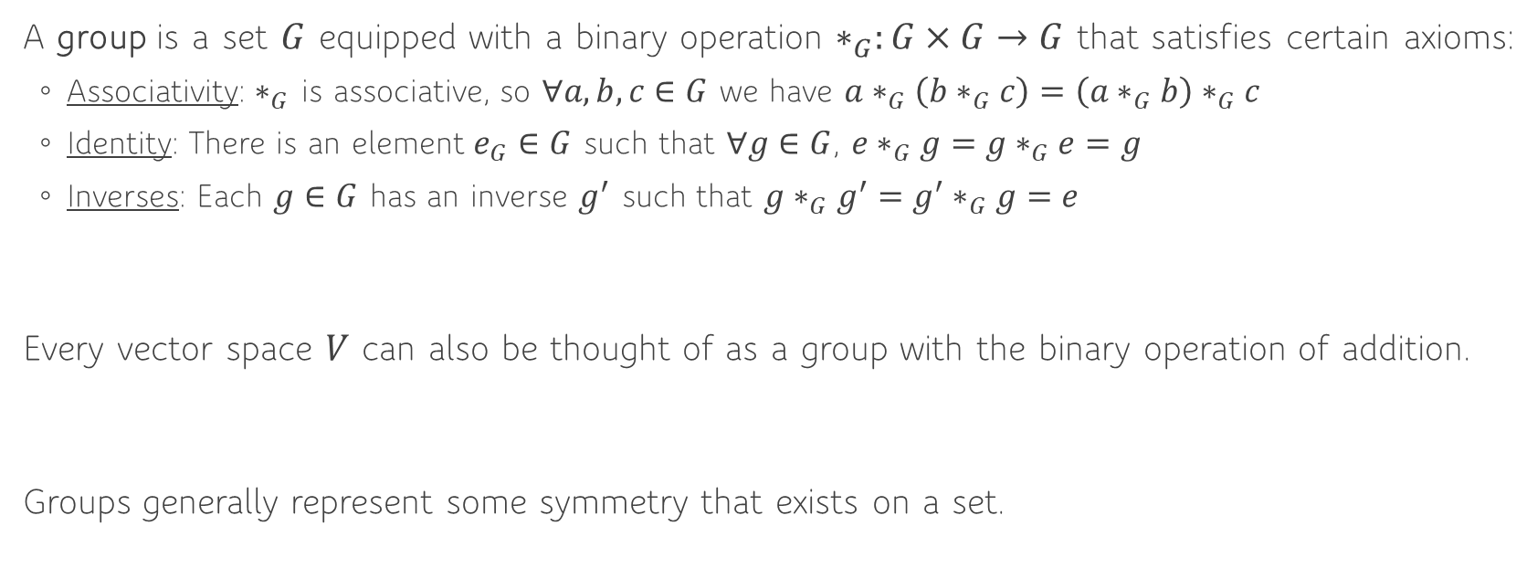
What is a Group?
A group is a set $G$ equipped with a binary operation $∗_{G}:G×G→G$ that satisfies certain axioms:
Associativity: $∗_{G}$ is associative, so $∀a, b, c∈G$ we have $a∗_{G}\left(b∗_{G}c\right)=\left(a∗_{G}b\right)∗_{G}c$
Identity: There is an element $e_{G}∈G$ such that $∀g∈G$, $e∗_{G}g=g∗_{G}e=g$
Inverses: Each $g∈G$ has an inverse $g^{′}$ such that $g∗_{G}g^{′}=g^{′}∗_{G}g=e$
Every vector space $V$ can also be thought of as a group with the binary operation of addition.
Groups generally represent some symmetry that exists on a set.
Notes:
Give examples of $ℝ$, $ℚ$, $ℤ$, but not $ℕ$

Slide 4
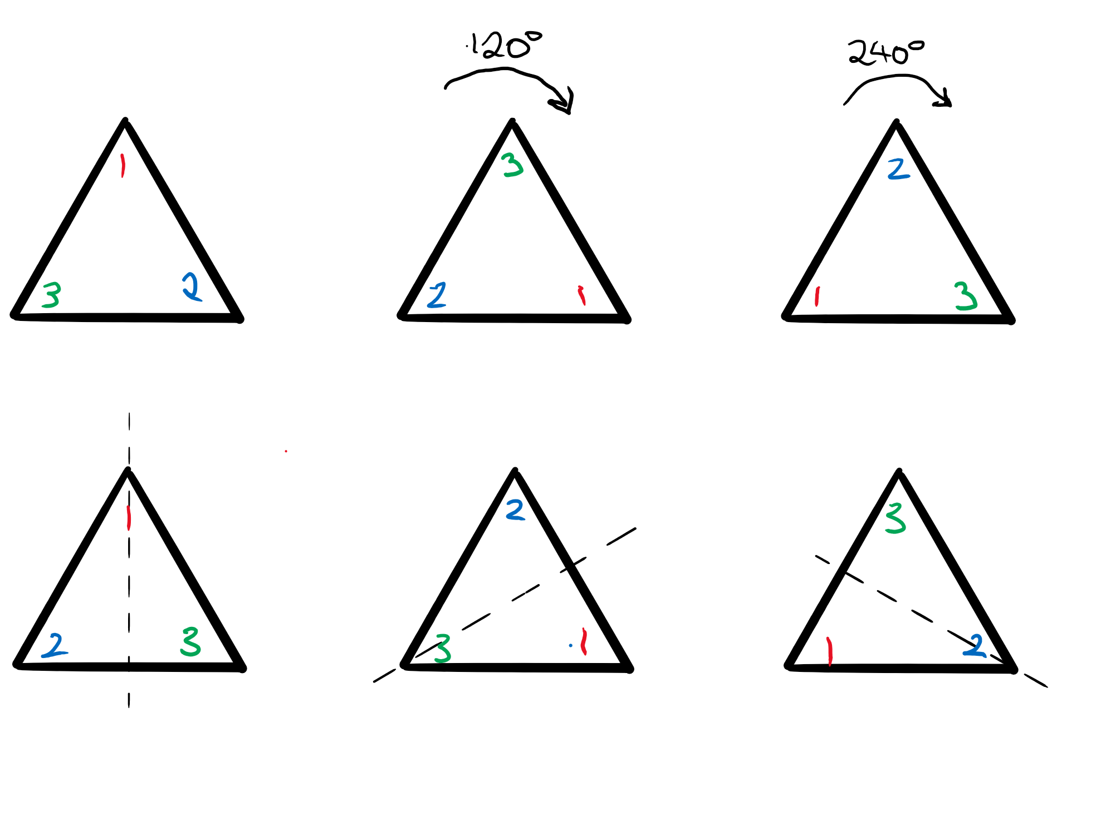

What is a Group?
Example: The group $D_{2n}$ is the symmetry group of regular $n$-gon. Specifically, we will mainly consider the group $D_{6}$, the symmetry group of the equilateral triangle:
Notes:
Show combining, e.g 120 rotation and then reflection in vertical axis makes bottom right element.
Examples of identity and inverse
State names of each transformation:
e r rr
s rrs rs
Talk about how r and s generate the group, and show Cayley graph – explain it is a coloured directed graph
Change generators: $\{s, rs\}$ and $\{r, rr\}$
First two are connected and so $S$ generates the group. Run DFS on uncoloured graph to check reachability.
Second one is disconnected, and so gives the cosets of $S^{G}$, the union of conjugacy classes of elements in $S$, in $G$.

Slide 5
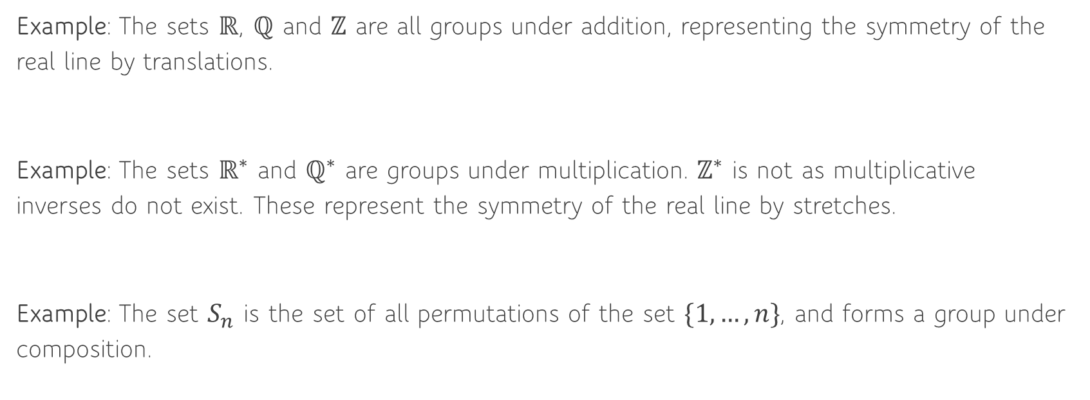
What is a Group?
Example: The sets $ℝ$, $ℚ$ and $ℤ$ are all groups under addition, representing the symmetry of the real line by translations.
Example: The sets $ℝ^{∗}$ and $ℚ^{∗}$ are groups under multiplication. $ℤ^{∗}$ is not as multiplicative inverses do not exist. These represent the symmetry of the real line by stretches.
Example: The set $S_{n}$ is the set of all permutations of the set $\{1, …, n\}$, and forms a group under composition.

Slide 6
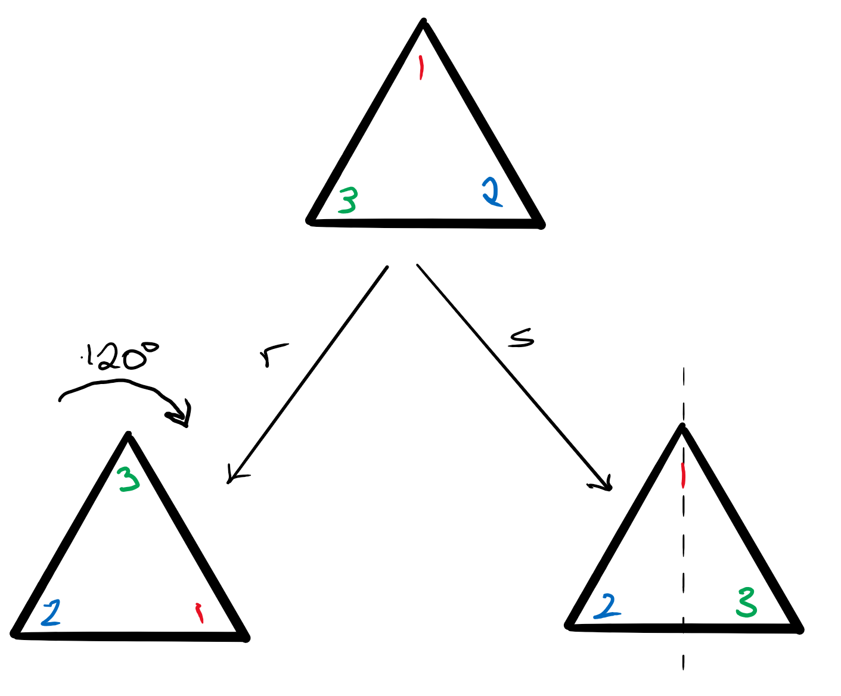
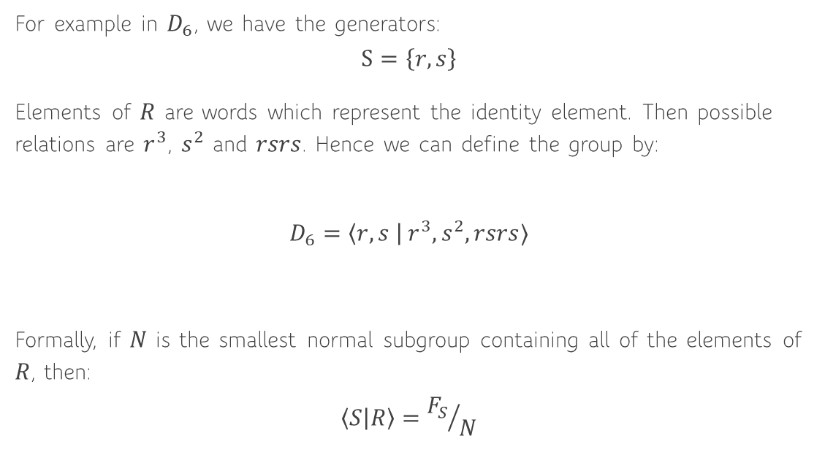
Presentations
For example in $D_{6}$, we have the generators:
$$S=\left\{r, s\right\}$$
Elements of $R$ are words which represent the identity element. Then possible relations are $r^{3}$, $s^{2}$ and $rsrs$. Hence we can define the group by:
$$D_{6}=\left\langle r, s \right| r^{3}, s^{2}, rsrs⟩$$
Formally, if $N$ is the smallest normal subgroup containing all of the elements of $R$, then:
$$\left\langle S | R\right\rangle ={F_{S}}/N$$
Notes:
Without any relations, we just get the free group, which is all words that can be made of the letters in S
$$N=R^{F_{s}}=\left\{g^{−1}sg^{−1} \right| g∈F_{s}, s∈R\}$$
Which means that $N⊴G$ and we can find the quotient group. Intuitively represents all of the elements that correspond to the identity.
A group is finitely presented is both $S$ and $R$ are finite.

Slide 7
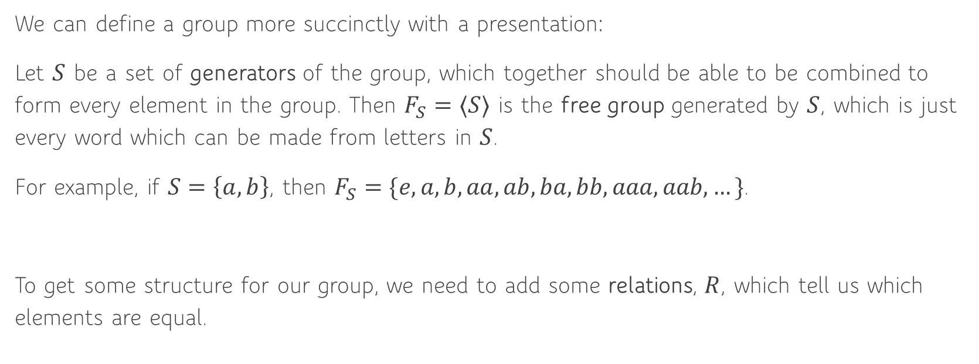
Presentations
We can define a group more succinctly with a presentation:
Let $S$ be a set of generators of the group, which together should be able to be combined to form every element in the group. Then $F_{S}=⟨S⟩$ is the free group generated by $S$, which is just every word which can be made from letters in $S$.
For example, if $S=\left\{a, b\right\}$, then $F_{S}=\{e, a, b, aa, ab, ba, bb, aaa, aab, …\}$.
To get some structure for our group, we need to add some relations, $R$, which tell us which elements are equal.

Slide 8
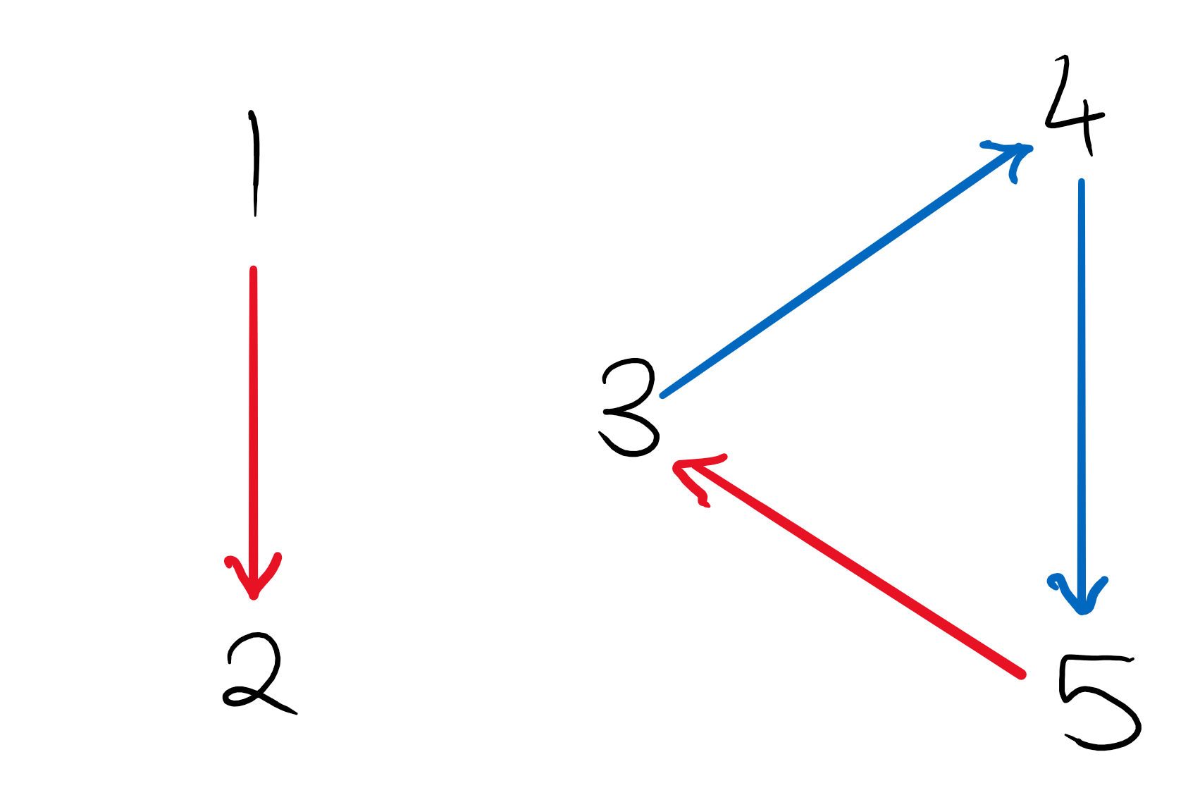
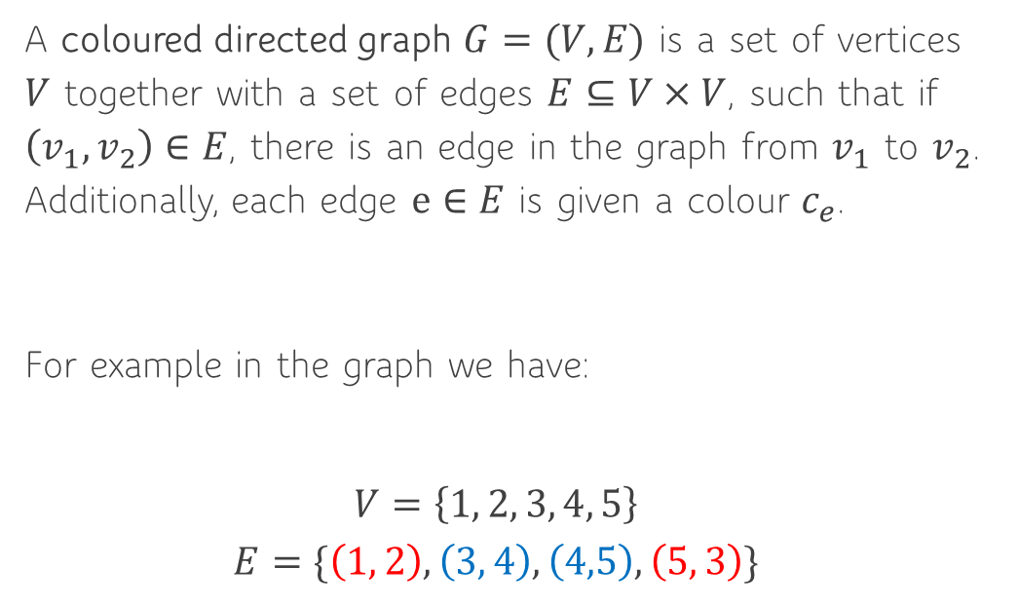
Graphs
A coloured directed graph $G=(V, E)$ is a set of vertices $V$ together with a set of edges $E⊆V×V$, such that if $\left(v_{1},v_{2}\right)∈E$, there is an edge in the graph from $v_{1}$ to $v_{2}$. Additionally, each edge $e∈E$ is given a colour $c_{e}$.
For example in the graph we have:
$$V=\left\{1, 2, 3, 4, 5\right\}$$
$$E=\{\left(1, 2\right), \left(3, 4\right), \left(4,5\right), \left(5, 3\right)\}$$

Slide 9

Cayley Graphs
Example: The Cayley graph of $D_{6}$.
$S=\{r,s\}$
$S=\{s, rs\}$
$S=\{r, rr\}$ – not a generating set so disconnected, giving the cosets of $S^{G}$ in $G$
Using DFS to check if a set is generating
Notes:
First two are connected and so $S$ generates the group. Run DFS on uncoloured graph to check reachability.
Second one is disconnected, and so gives the cosets of $S^{G}$, the union of conjugacy classes of elements in $S$, in $G$.

Slide 10
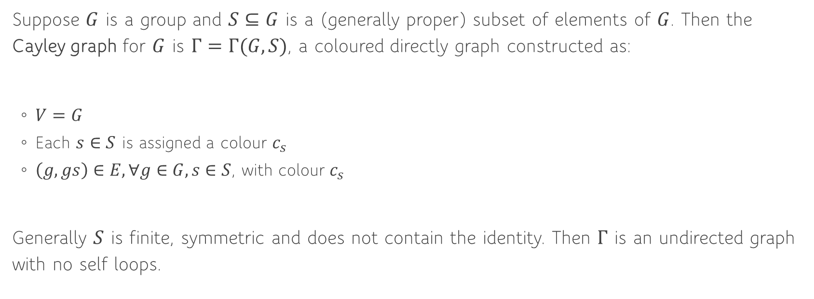
Cayley Graphs
Suppose $G$ is a group and $S⊆G$ is a (generally proper) subset of elements of $G$. Then the Cayley graph for $G$ is $Γ=Γ(G, S)$, a coloured directly graph constructed as:
$V=G$
Each $s∈S$ is assigned a colour $c_{s}$
$\left(g, gs\right)∈E, ∀g∈G, s∈S$, with colour $c_{s}$
Generally $S$ is finite, symmetric and does not contain the identity. Then $Γ$ is an undirected graph with no self loops.
Notes:
Can put the word metric on this graph to give it the structure of a metric space, especially in infinite groups.

Slide 11
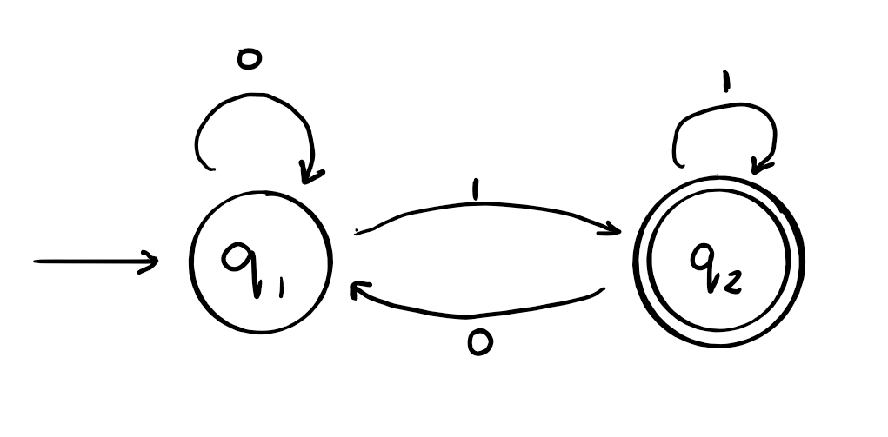
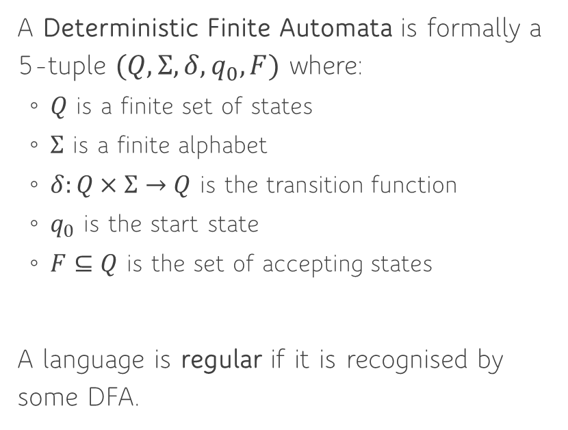
Deterministic Finite Automata
A Deterministic Finite Automata is formally a 5-tuple $(Q, Σ, δ, q_{0}, F)$ where:
$Q$ is a finite set of states
$Σ$ is a finite alphabet
$δ:Q×Σ→Q$ is the transition function
$q_{0}$ is the start state
$F⊆Q$ is the set of accepting states
A language is regular if it is recognised by some DFA.
Notes:
Explain what a DFA is – a model of computation (formalism of an algorithm) with no external memory and the input word is consumed as it is read.
Language recognised by a DFA – follow the path on the graph corresponding to the word (e.g. 00101) and see if we reach an accepting state.
If a language is regular, then the problem that is being solved can be solved with bounded memory and linear running time.
DFA on the right accepts all words which end in a 1

Slide 12
Word Problem

Slide 13

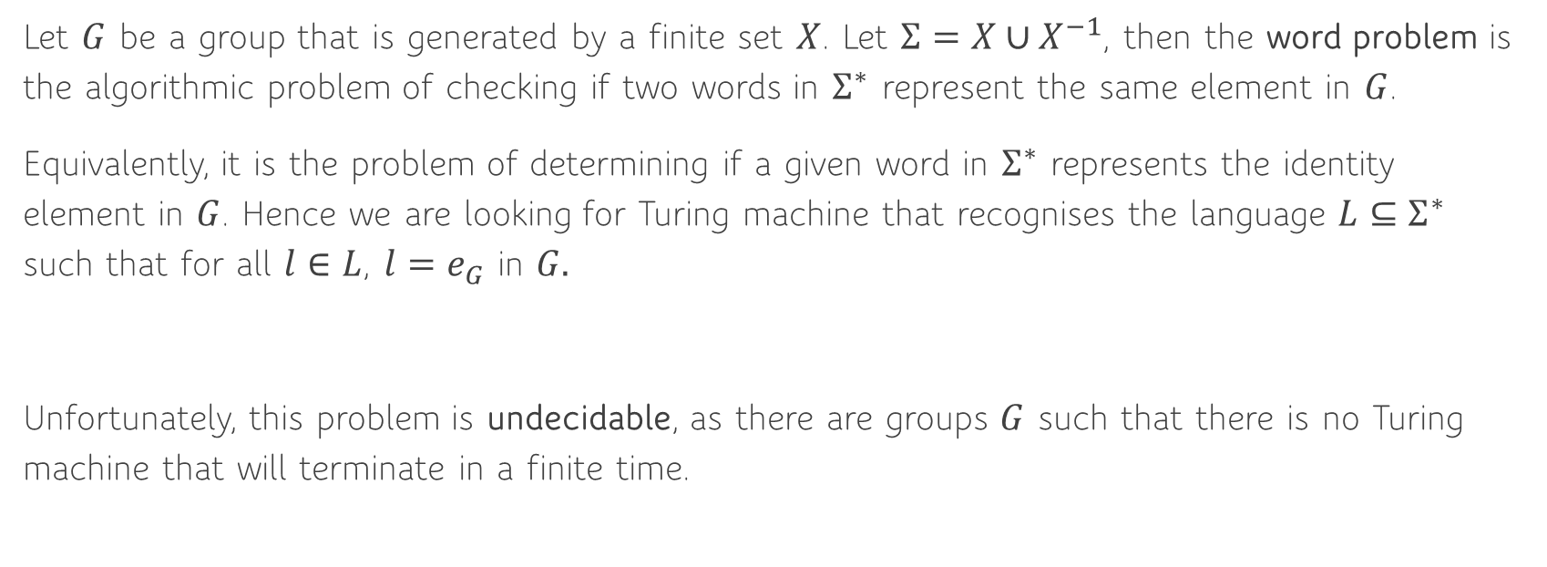
Word Problem for a Group $G$
Let $G$ be a group that is generated by a finite set $X$. Let $Σ=X∪X^{−1}$, then the word problem is the algorithmic problem of checking if two words in $Σ^{∗}$ represent the same element in $G$.
Equivalently, it is the problem of determining if a given word in $Σ^{∗}$ represents the identity element in $G$. Hence we are looking for Turing machine that recognises the language $L⊆Σ^{∗}$ such that for all $l∈L$, $l=e_{G}$ in $G.$
Unfortunately, this problem is undecidable, as there are groups $G$ such that there is no Turing machine that will terminate in a finite time.
Notes:
Undecidable as there is no way to reduce a word to a canonical form for an element in the group algorithmically.

Slide 14
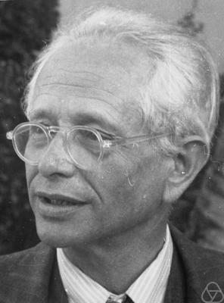
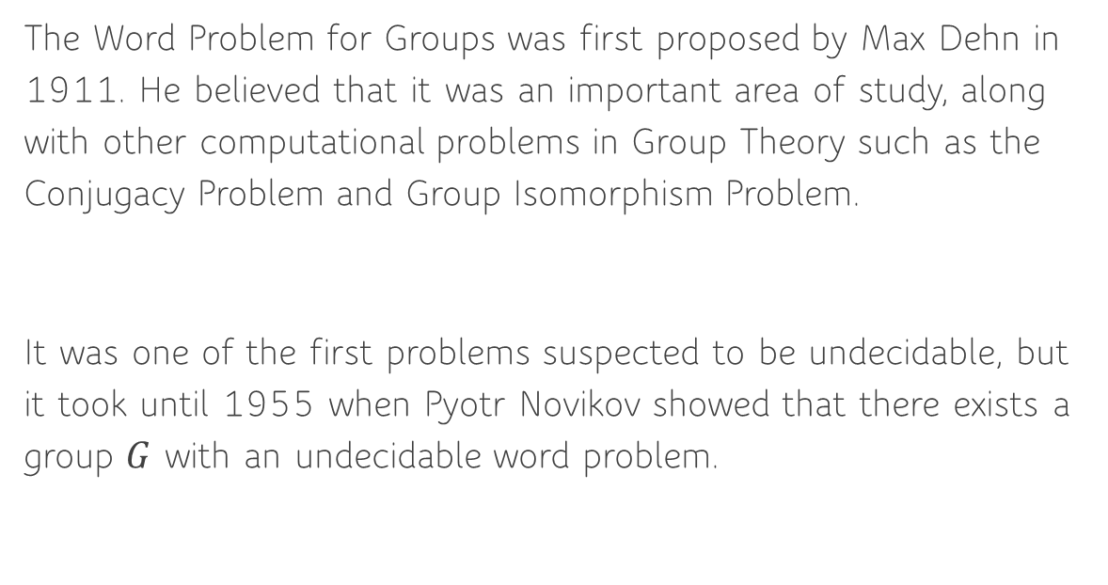
History of the Word Problem
The Word Problem for Groups was first proposed by Max Dehn in 1911. He believed that it was an important area of study, along with other computational problems in Group Theory such as the Conjugacy Problem and Group Isomorphism Problem.
It was one of the first problems suspected to be undecidable, but it took until 1955 when Pyotr Novikov showed that there exists a group $G$ with an undecidable word problem.
Notes:
The uniform word problem is the algorithmic problem of deciding, given a presentation of a group $G=⟨S|R⟩$ and two words in $Σ^{∗}={\left(S∪S^{−1}\right)}^{∗}$, if the two words represent the same element in $G$. This is also undecidable as there are specific groups for which the problem is undecidable.
In fact it is worse, this problem is RE-complete, which means it is one of the hardest problems for which a Turing machine exists that partially solves it. Every other RE problem can therefore be reduced to the Uniform Word Problem.

Slide 15
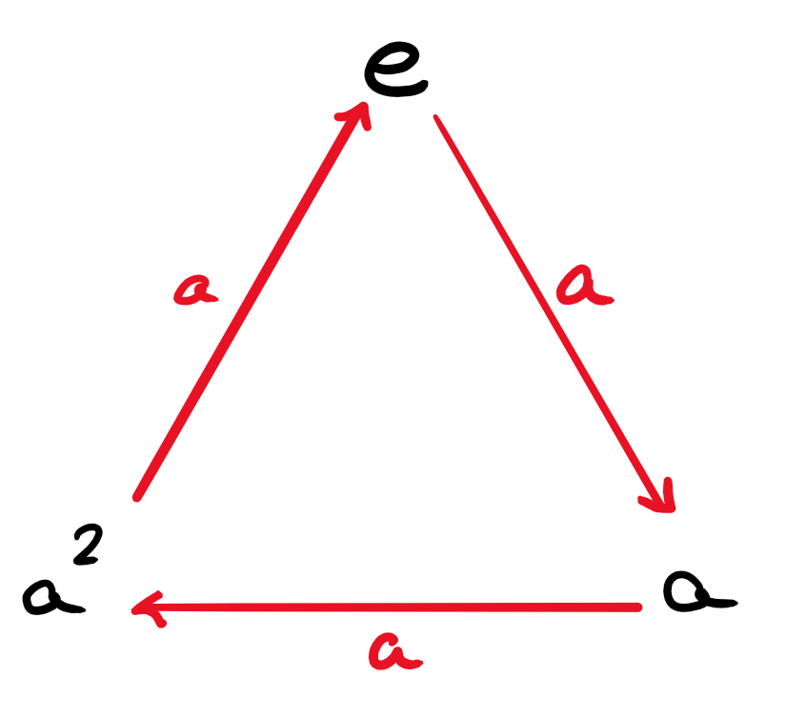

Solvable Word Problems
Example: (The Word Problem for $C_{3}$)
Consider the cyclic group $C_{3}$ generated by:
$$C_{3}=⟨a|a^{3}⟩$$
Now consider a word $w∈{\left\{a, a^{−1}\right\}}^{∗}$. If any of:
$$aaa, a^{−1}a^{−1}a^{−1}, aa^{−1}, a^{−1}a$$
appear in the word, we can remove them from $w$ as they represent the identity element. Hence we can reduce $w$ to one of:
$$ε, a, aa, a^{−1}, a^{−1}a^{−1}$$

Slide 16



Solvable Word Problems
Next we can write $a^{−1}=aa$ and $a^{−1}a^{−1}=a$, and therefore reduce $w$ to one of:
$$ε, a, aa, a^{−1}, a^{−1}a^{−1}$$
Hence solving the word problem.
In a general group, it may be impossible monotonically reduce every word $w$ to a canonical form of a element, for example $sr$ in $D_{6}$.

Slide 17
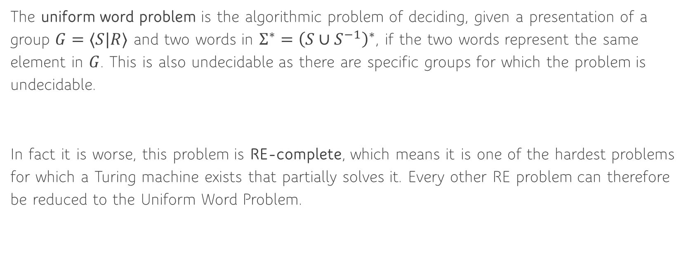
Uniform Word Problem
The uniform word problem is the algorithmic problem of deciding, given a presentation of a group $G=⟨S|R⟩$ and two words in $Σ^{∗}={\left(S∪S^{−1}\right)}^{∗}$, if the two words represent the same element in $G$. This is also undecidable as there are specific groups for which the problem is undecidable.
In fact it is worse, this problem is RE-complete, which means it is one of the hardest problems for which a Turing machine exists that partially solves it. Every other RE problem can therefore be reduced to the Uniform Word Problem.

Slide 18
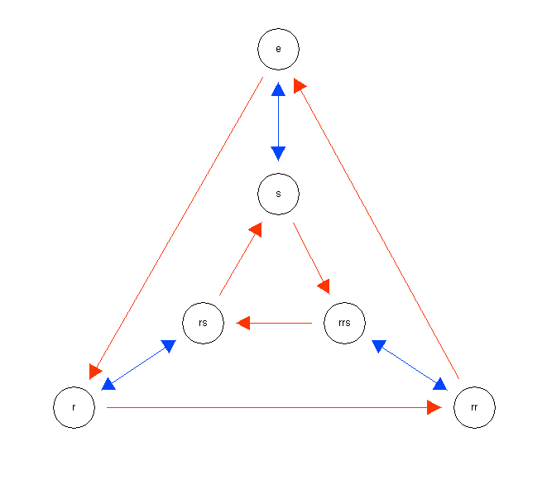
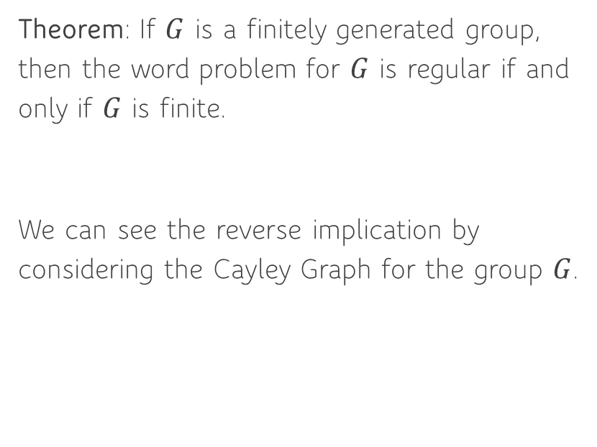
Connection to DFAs
Theorem: If $G$ is a finitely generated group, then the word problem for $G$ is regular if and only if $G$ is finite.
We can see the reverse implication by considering the Cayley Graph for the group $G$.
Notes:
Draw on final states and initial arrow onto the graph to make it into a DFA.

Slide 19
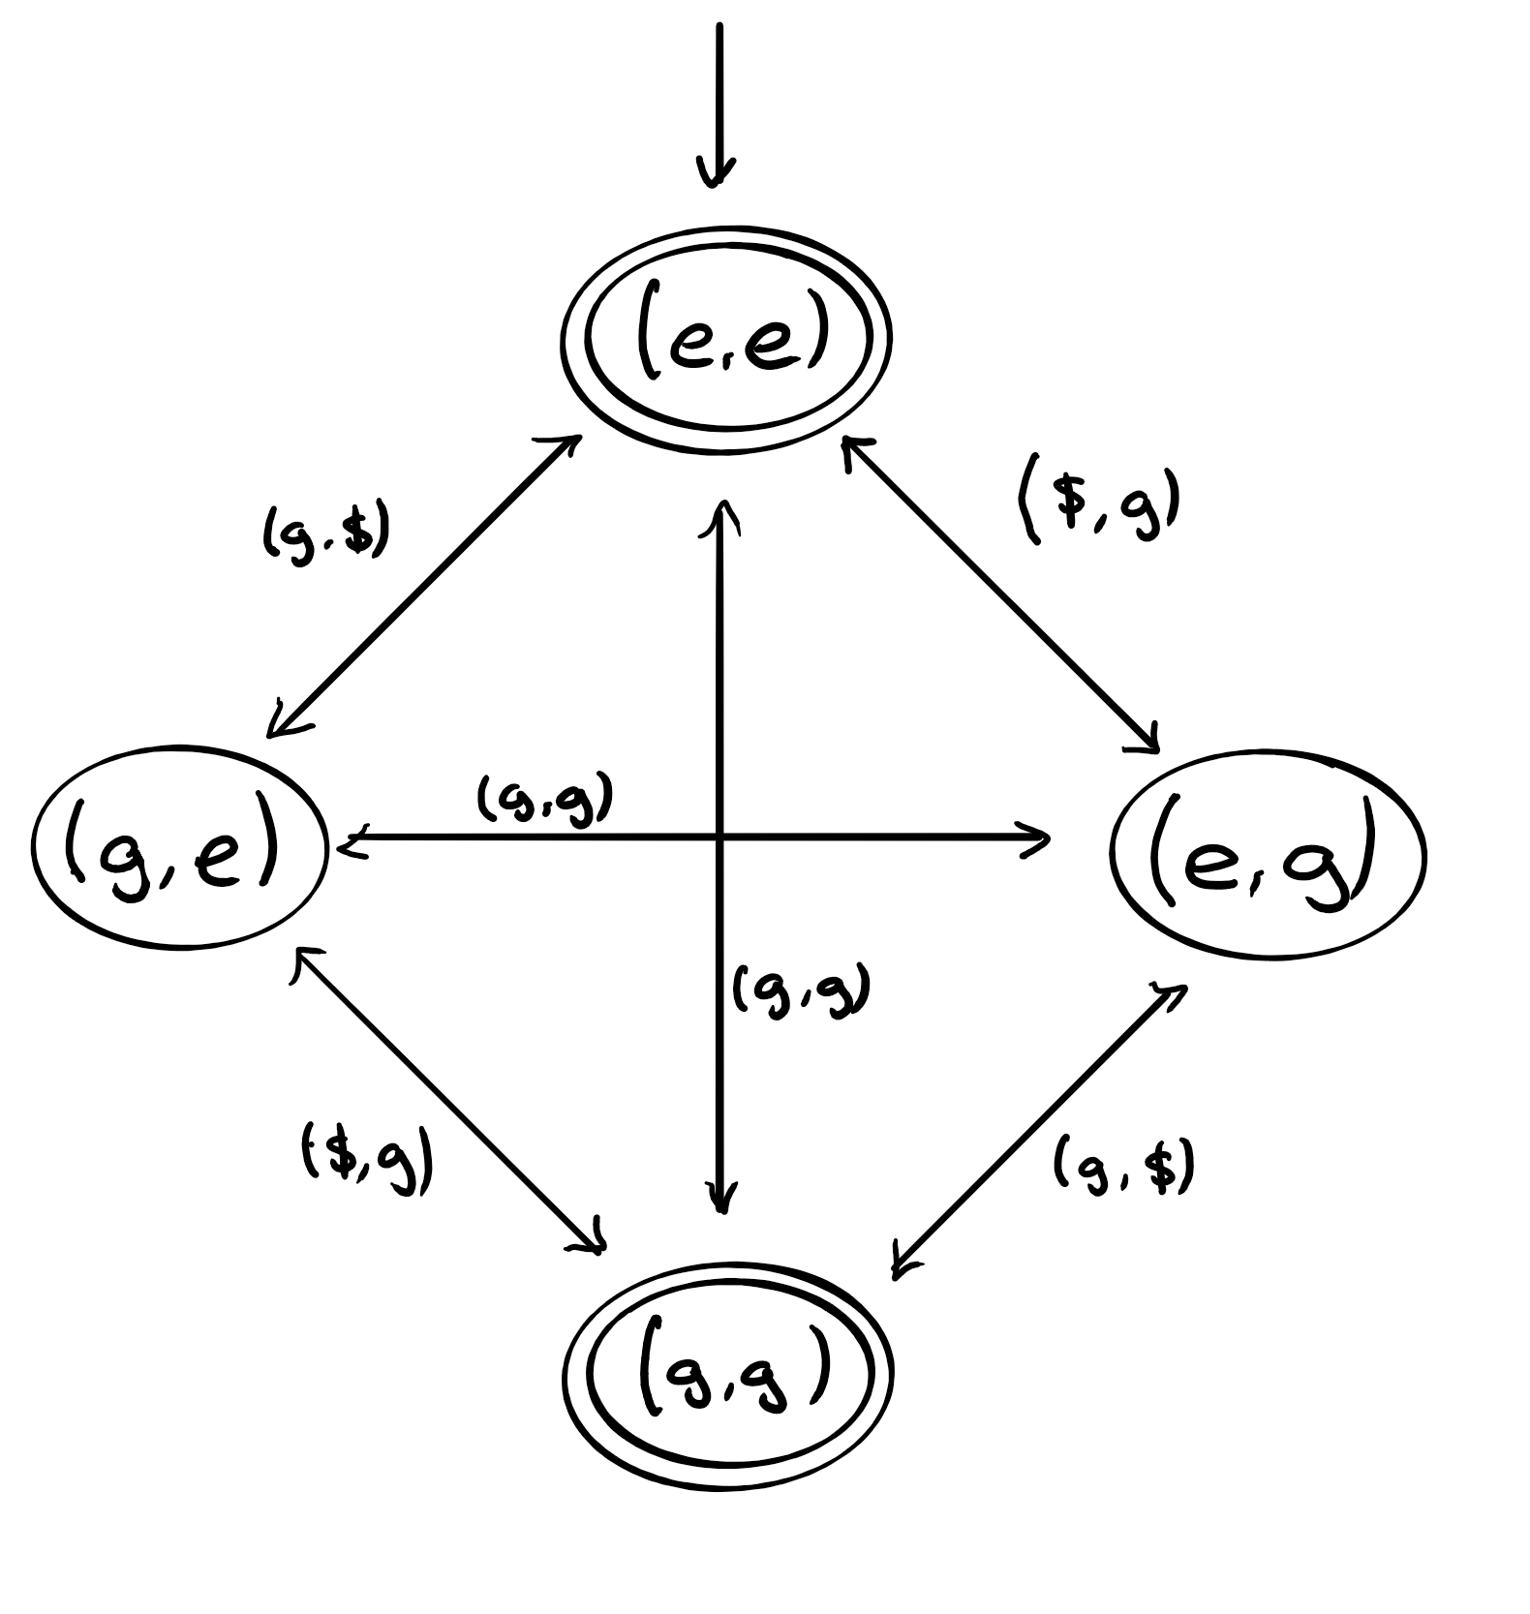
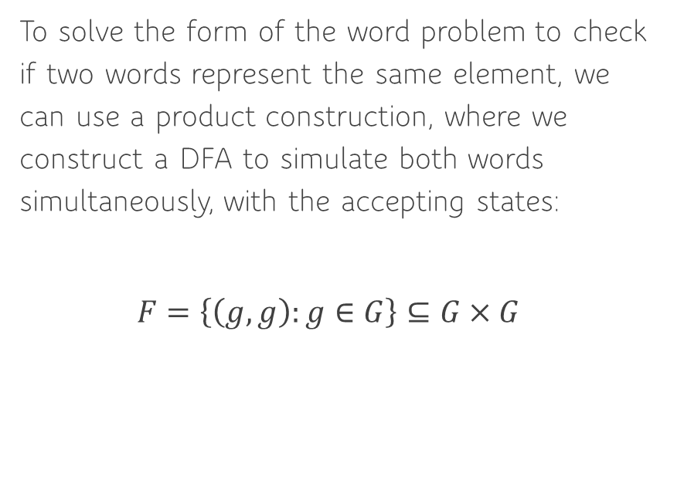
Connection to DFAs
To solve the form of the word problem to check if two words represent the same element, we can use a product construction, where we construct a DFA to simulate both words simultaneously, with the accepting states:
$$F=\left\{\left(g, g\right):g∈G\right\}⊆G×G$$
Notes:
Similar result for context free problems, where $G$ needs to be virtually free for the problem to be context free.

Slide 20
Todd-Coxeter Algorithm

Slide 21
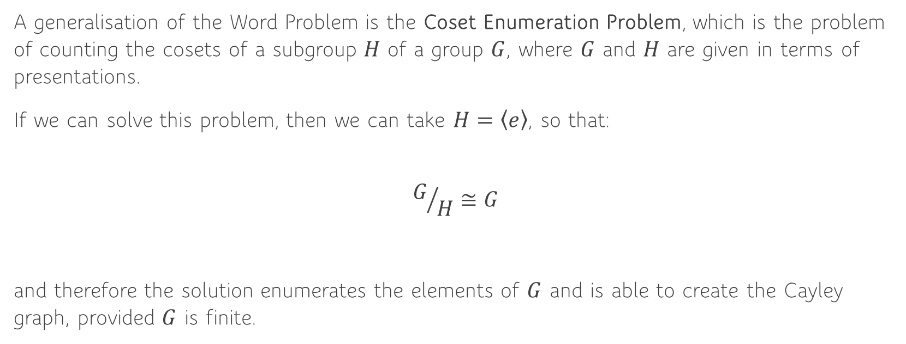
Coset Enumeration Problem
A generalisation of the Word Problem is the Coset Enumeration Problem, which is the problem of counting the cosets of a subgroup $H$ of a group $G$, where $G$ and $H$ are given in terms of presentations.
If we can solve this problem, then we can take $H=\left\langle e\right\rangle$, so that:
$$G/H≅G$$
and therefore the solution enumerates the elements of $G$ and is able to create the Cayley graph, provided $G$ is finite.
Notes:
Explain what a coset is.

Slide 22
Coset Enumeration Problem
The original algorithm to solve this was the Todd-Coxeter Algorithm, which was created in 1936.
It is very difficult to determine how much memory or time is required for any algorithm that solves the Word Problem, as there are some groups such that the problem is unsolvable. The resource requirements are also very sensitive to the presentation that is used.
However, for any finite group it must terminate in finite time.
Notes:
A generalisation of the Word Problem is the Coset Enumeration Problem, which is the problem of counting the cosets of a subgroup $H$ of a group $G$, where $G$ and $H$ are given in terms of presentations.
If we can solve this problem, then we can take $H=\left\langle e\right\rangle$, so that:
$$G/H≅G$$

Slide 23
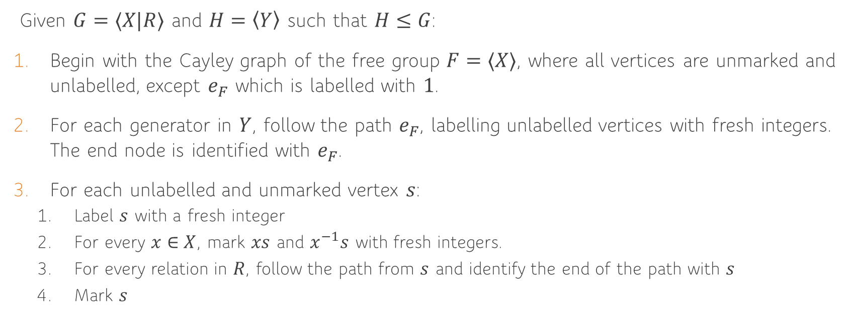
Formal Description
Given $G=⟨X|R⟩$ and $H=\left\langle Y\right\rangle$ such that $H≤G$:
Begin with the Cayley graph of the free group $F=⟨X⟩$, where all vertices are unmarked and unlabelled, except $e_{F}$ which is labelled with $1$.
For each generator in $Y$, follow the path $e_{F}$, labelling unlabelled vertices with fresh integers. The end node is identified with $e_{F}$.
For each unlabelled and unmarked vertex $s$:
Label $s$ with a fresh integer
For every $x∈X$, mark $xs$ and $x^{−1}s$ with fresh integers.
For every relation in $R$, follow the path from $s$ and identify the end of the path with $s$
Mark $s$

Slide 24
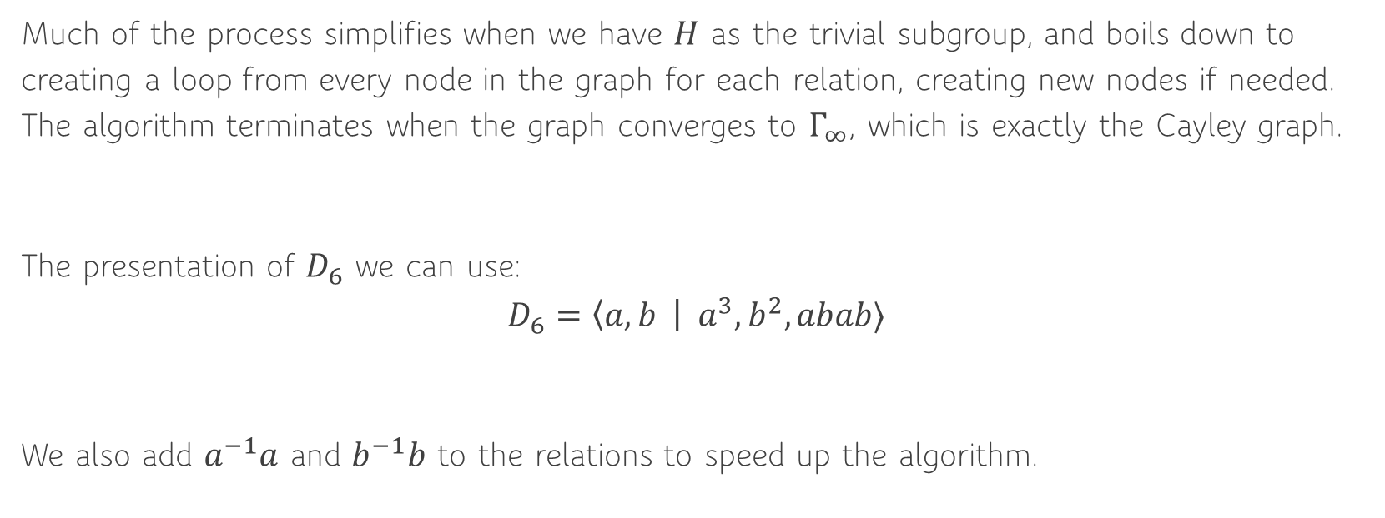

Example: $D_{6}$
Much of the process simplifies when we have $H$ as the trivial subgroup, and boils down to creating a loop from every node in the graph for each relation, creating new nodes if needed. The algorithm terminates when the graph converges to $Γ_{∞}$, which is exactly the Cayley graph.
The presentation of $D_{6}$ we can use:
$$D_{6}=\left\langle a, b \right| a^{3},b^{2},abab⟩$$
We also add $a^{−1}a$ and $b^{−1}b$ to the relations to speed up the algorithm.

Slide 25


Example: $D_{6}$
We start with a single node $0$, which represents the identity element in the group.
Notes:
Reminder: We are premultiplying so we go right to left
Also not plotting inverse arrows
Next is $a^{−1}a$

Slide 26
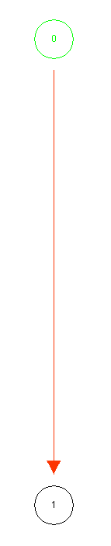
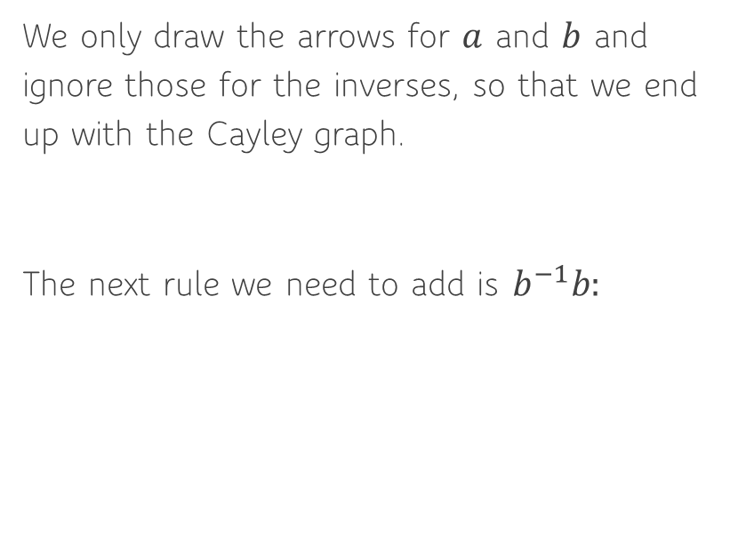
Example: $D_{6}$
We only draw the arrows for $a$ and $b$ and ignore those for the inverses, so that we end up with the Cayley graph.
The next rule we need to add is $b^{−1}b:$
Notes:
New nodes to be created with blue arrow

Slide 27
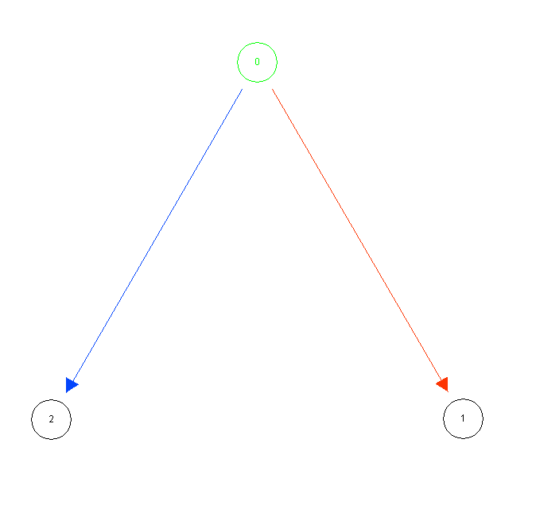

Example: $D_{6}$
The next rule is $a^{3}$:
As node $0$ already as a edge for $a$, we first follow that, but then need to introduce two new nodes from $1$.

Slide 28
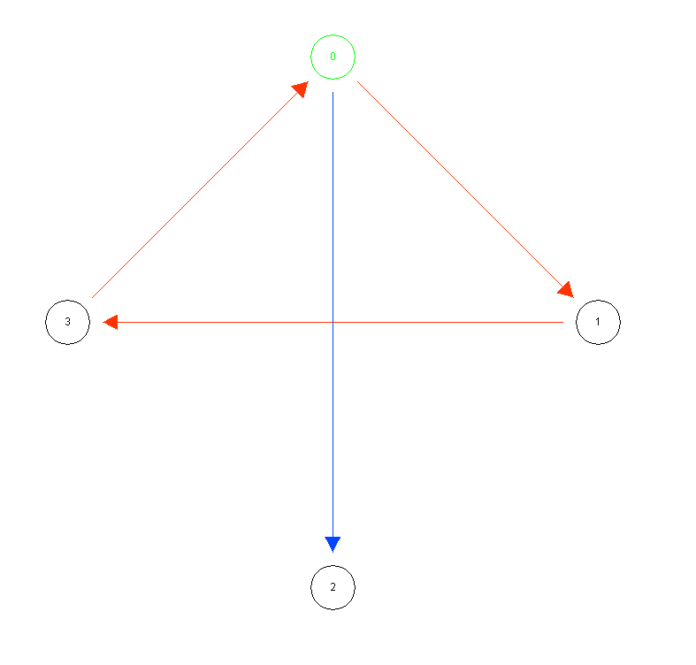

Example: $D_{6}$
The next rule is $b^{2}$.
Again we can follow the $b$ edge from node $0$, but then we need 1 new node for the second $b$ edge from node $2$.

Slide 29
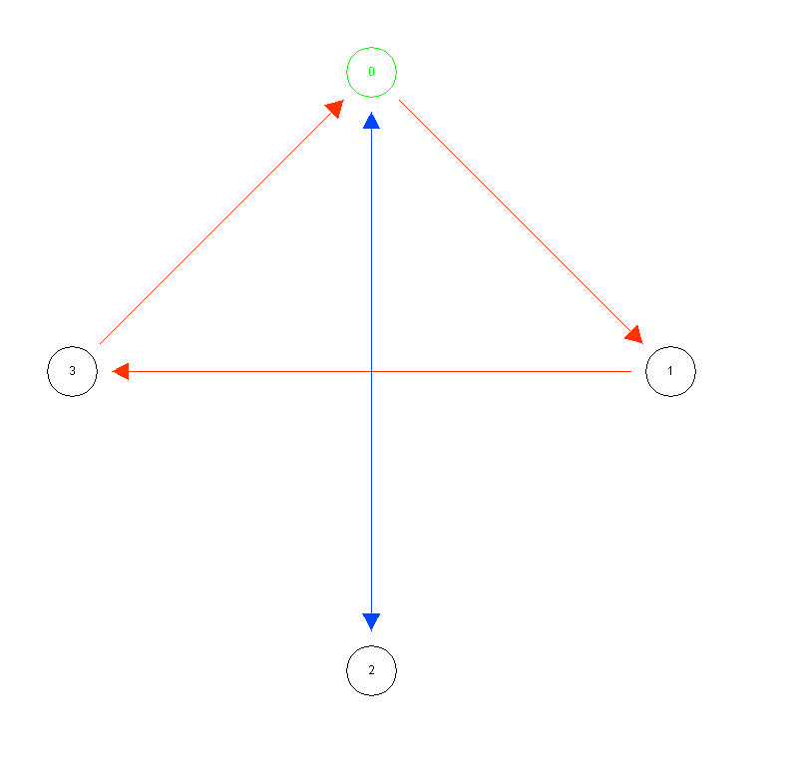

Example: $D_{6}$
The final rule to add is $abab$:

Slide 30
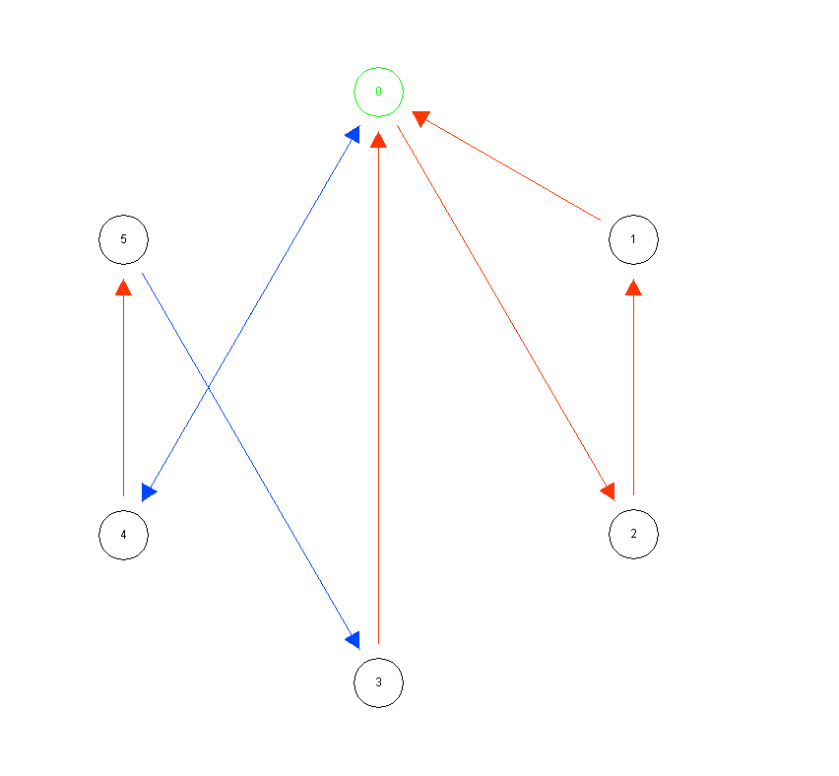

Example: $D_{6}$
We have now added every loop to node $0$, and can move onto node $1$.
At the end of the process, we get exactly the Cayley Graph of $D_{6}$.
Notes:
Run entire animation for this group

Slide 31
Knuth-Bendix Algorithm

Slide 32
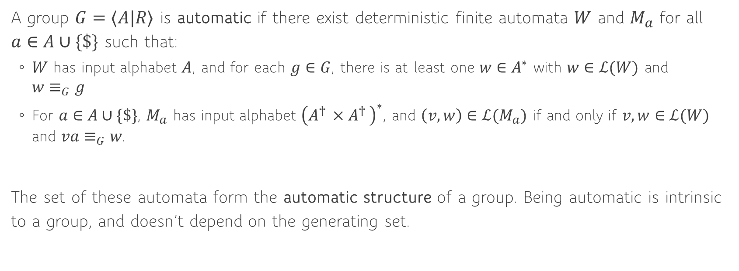
Automatic Groups
A group $G=⟨A|R⟩$ is automatic if there exist deterministic finite automata $W$ and $M_{a}$ for all $a∈A∪\{\$\}$ such that:
$W$ has input alphabet $A$, and for each $g∈G$, there is at least one $w∈A^{∗}$ with $w∈ℒ(W)$ and $w≡_{G}g$
For $a∈A∪\{\$\}$, $M_{a}$ has input alphabet ${\left(A^{† }×A^{† }\right)}^{∗}$, and $\left(v, w\right)∈ℒ(M_{a})$ if and only if $v, w∈ℒ(W)$ and $va≡_{G}w$.
The set of these automata form the automatic structure of a group. Being automatic is intrinsic to a group, and doesn’t depend on the generating set.
Notes:
Word acceptor:
We can restrict to a unique element, which is always possible as we can remove duplicates.
Accepts a single word in each equivalence class, so we can check if an element is in canonical form.
Multiplier:
A machine tells us how to get from one element to another.
We need $A^{† }$ - the set of padded words – in case the words are different lengths.

Slide 33
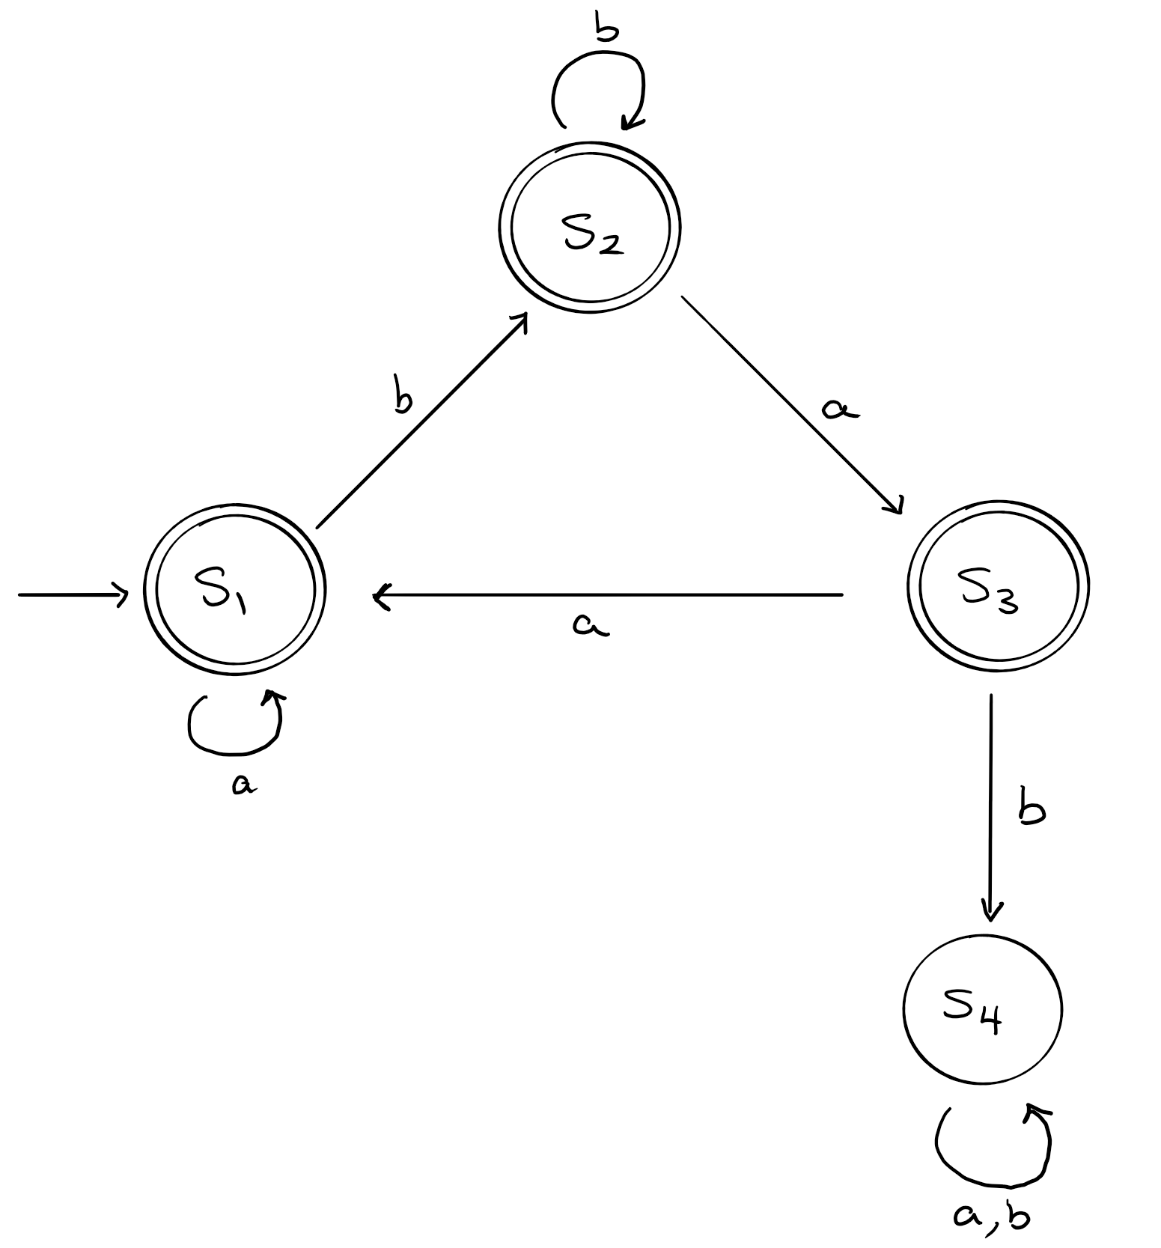

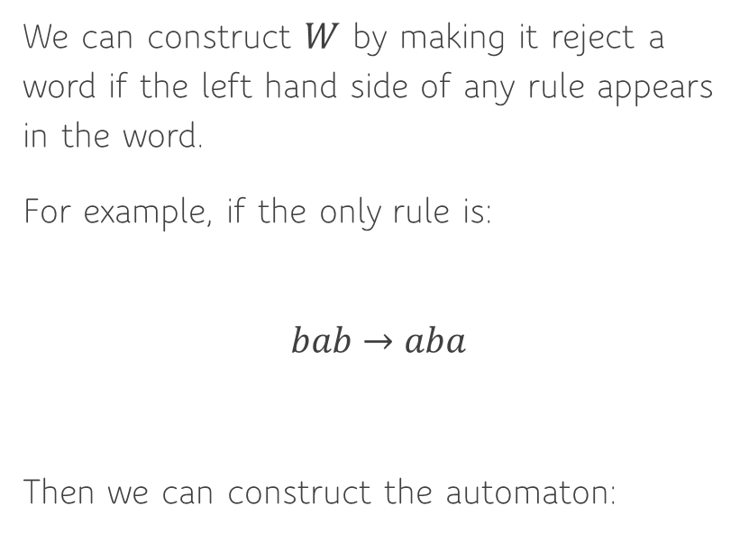
Constructing $W$
We can construct $W$ by making it reject a word if the left hand side of any rule appears in the word.
For example, if the only rule is:
$$bab→aba$$
Then we can construct the automaton:
Notes:
Explain how if we ever see $bab$ we reach state $s_{4}$
Can use this to check if we can reduce a word further, and then reject if we can.
However this single rule is not enough to uniquely reduce every word corresponding to $g$

Slide 34

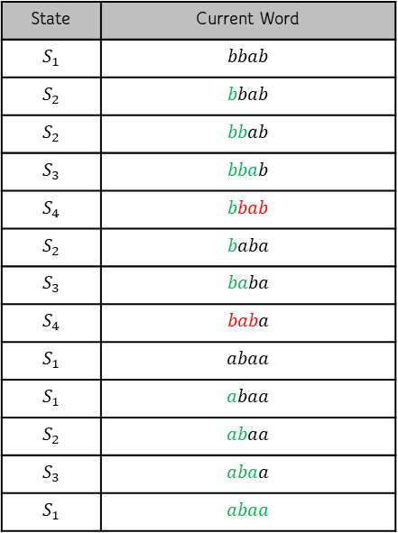
Solving the Word Problem
Given the input word $bbab$, we can reduce that:
State | Current Word
$$S_{1}$$ | $$bbab$$
$$S_{2}$$ | $$bbab$$
$$S_{2}$$ | $$bbab$$
$$S_{3}$$ | $$bbab$$
$$S_{4}$$ | $$bbab$$
$$S_{2}$$ | $$baba$$
$$S_{3}$$ | $$baba$$
$$S_{4}$$ | $$baba$$
$$S_{1}$$ | $$abaa$$
$$S_{1}$$ | $$abaa$$
$$S_{2}$$ | $$abaa$$
$$S_{3}$$ | $$abaa$$
$$S_{1}$$ | $$abaa$$
Notes:
At first $S_{4}$, we rewind back to the second state.
At second $S_{4}$, we rewind to the first state.
So we know $abaa$ cannot be reduced further.
But we need every word to reduce correctly, most won’t. So need Knuth Bendix.

Slide 35
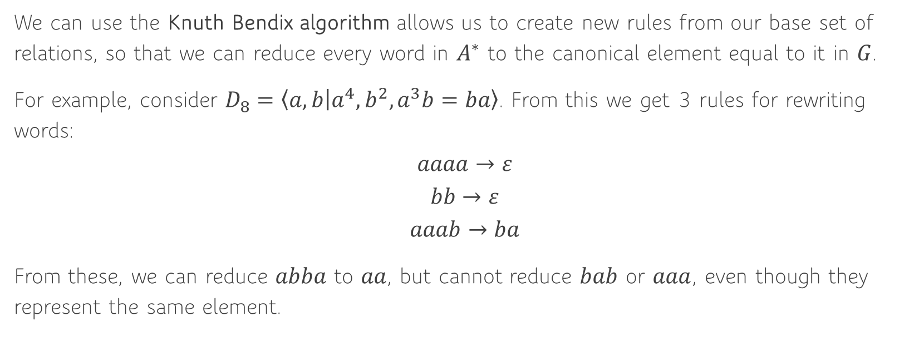
Knuth Bendix Algorithm
We can use the Knuth Bendix algorithm allows us to create new rules from our base set of relations, so that we can reduce every word in $A^{∗}$ to the canonical element equal to it in $G$.
For example, consider $D_{8}=\left\langle a, b | a^{4},b^{2},a^{3}b=ba\right\rangle$. From this we get 3 rules for rewriting words:
$$aaaa→ε$$
$$bb→ε$$
$$aaab→ba$$
From these, we can reduce $abba$ to $aa$, but cannot reduce $bab$ or $aaa$, even though they represent the same element.
Notes:
As we know they represent the same element in $G$, we can create a new rule connecting them.
But how do we know they represent the same element from the presentation.

Slide 36


Knuth Bendix Algorithm
Consider the word $aaabb$, then we can reduce it either as:
$$aaabb→bab$$
$$aaabb→aaa$$
And hence we know they represent the same element, and can add the rule $bab→aaa$, and hence now both reduce to the same element.
$$aaaa→ε$$
$$bb→ε$$
$$aaab→ba$$
Notes:
Using rule 3
Using rule 2

Slide 37

Knuth Bendix Algorithm
In general, if there are two rules $L_{1}→R_{1}$ and $L_{2}→R_{2}$ such that:
$$L_{1}=AB L_{2}=BC$$
Then we have the two reductions:
$$ABC=L_{1}C→R_{1}C$$
$$ABC=AL_{2}→AR_{2}$$
Hence we can add the rule $R_{1}C→AR_{2}$.
Notes:
The pair of rules is called a critical pair.
We repeat this process until there are no more critical pairs. At this point, we can create the DFA that rejects if any LHS of a rule is a substring, and use that as $W$. This is known as a confluent set of rules.

Slide 38
Knuth Bendix Algorithm
There are a couple of technicalities we have to worry about:
To guarantee we reduce a word, we need an ordering on the words. For example, we can use the length of the words, and if two words have the same length, use alphabetical order.
If we create a new rule, the LHS of an existing rule may become reducible, making this rule redundant.
This process works for a much larger category of groups, including some infinite groups.
Notes:
Ordering – need to make sure all the rules go down in the ordering
We don’t need to enumerate all elements of the group, only enough rules to be able to reduce every element in $A^{∗}$ to a canonical element in the group.

Slide 39
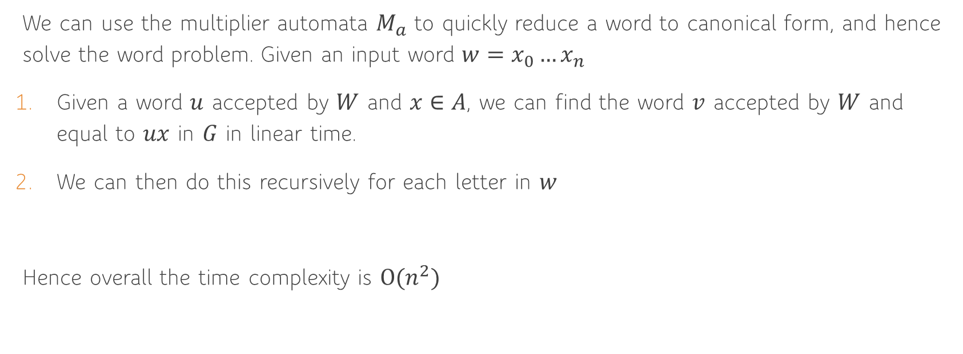
Complexity
We can use the multiplier automata $M_{a}$ to quickly reduce a word to canonical form, and hence solve the word problem. Given an input word $w=x_{0}…x_{n}$
Given a word $u$ accepted by $W$ and $x∈A$, we can find the word $v$ accepted by $W$ and equal to $ux$ in $G$ in linear time.
We can then do this recursively for each letter in $w$
Hence overall the time complexity is $O(n^{2})$
Notes:
1. Turn the multiplier automaton into an NFA $M′$ by ignoring the second element, then $M′$ recognises some pair $(u^{′},v′)$ where $u^{′}$ and $v′$ are padded words and $v′$ is at most $N$ letters longer.

Slide 40
Summary
Todd Coxeter Algorithm
Knuth Bendix Algorithm
Using Multiplier Automata
Notes:
Todd Coxeter:
Works on all finite groups
Has to enumerate all the elements so not for infinite groups
Knuth Bendix:
Only need enough rules so now works for some infinite groups
Multiplier Automata:
Get a fast running time $O(n^{2})$

